Slide 1
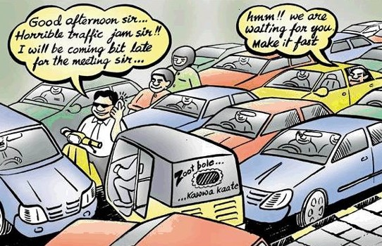
Route Optimization
Based On User Provided Data

Slide 2
Scope:
Employees
Students
Emergency Service
Transportation

Slide 3
Problem Statement:
It is known that traffic jam is a severe problem in Bangladesh. It is almost impossible to change the existing traffic system drastically with our limited resources. But what we can do is make the best use of the system that we have.

Slide 4
Problems:
Impact on Economy:
Loosing Work-Hours
Extra Transportation Cost
Extra Fuel Consumption
Vehicle Operating Cost

Slide 5
Problems:
Impact on Emergency Service:
Interruption of Ambulance Service
Interruption of Fire Service

Slide 6
Problems:
Miscellaneous:
Traffic congestion in Dhaka eats up
Taka 19,555 crore a year
People are loosing 1.3 man-hour per day
Delay in Medicine Supply
Employees and Students both are late to their
respective work area
Environment Pollution

Slide 7
Our Project Goal:
The goal of our project is to provide users with news of traffic jams and also help them by giving them the best possible route between two places using data provided by other users and media.

Slide 8
Existing Solution:
People mainly depend on media to get news
on traffic jam. But broadcasting stations have
men posted at main points of the city, not the
whole city. So we don’t get the specific picture.
Also the broadcasting stations give traffic updates
at scheduled times. So the situation can change.

Slide 9
Our Solution:
In our software we want to provide users
with information provided by users themselves.
This way the user can get the update of that instant.
Also we can take help from media stations to do this.

Slide 10
Feasibility:
Our software is mainly based on user data
Using this data we will provide relevant information
So it shouldn’t be tough to achieve our goal

